Slide 1
Drone delivery system unit
Day 5
Standards:
8.PS2.3
8PS2.4
8.PS2.5

Slide 2
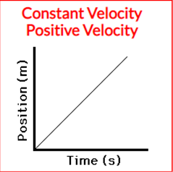

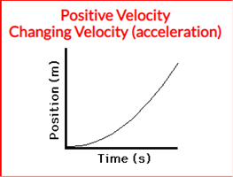
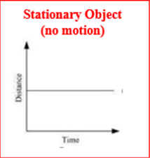
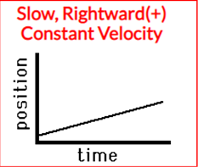
DQ
In 1969 astronauts first traveled to the Moon in the Saturn-5/Apollo spacecraft. It was the most powerful rocket ship ever built, and it was a three-stage rocket. This rocket ship blasted off from the launch pad in Florida and was propelled with ever increasing speed upwards through the Earth’s atmosphere flying towards the Moon.
Which one of the following graphs best represent the motion of this rocket ship after it blasted off from the launch pad?
a.
c.
d.
b.
Standards: 8.PS2.3, 8PS2.4, 8.PS2.5

Slide 3

Quiz in TEAMS
Log in to TEAMS and take the quiz assigned to you.
Submit when you are finished and put your computer away.
Revise your initial model of the drone delivery system.
This Photo by Unknown Author is licensed under CC BY-SA-NC
Standards: 8.PS2.3, 8PS2.4, 8.PS2.5

Slide 4
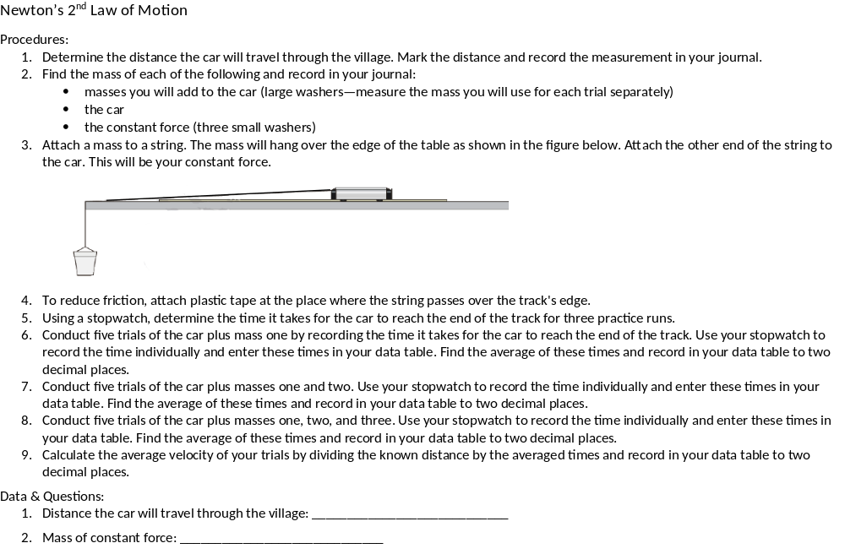
Standards: 8.PS2.3, 8PS2.4, 8.PS2.5

Slide 5
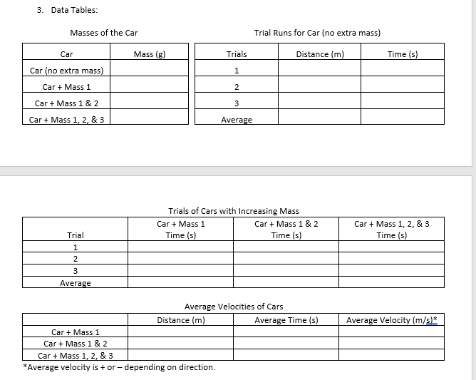
Standards: 8.PS2.3, 8PS2.4, 8.PS2.5

Slide 6
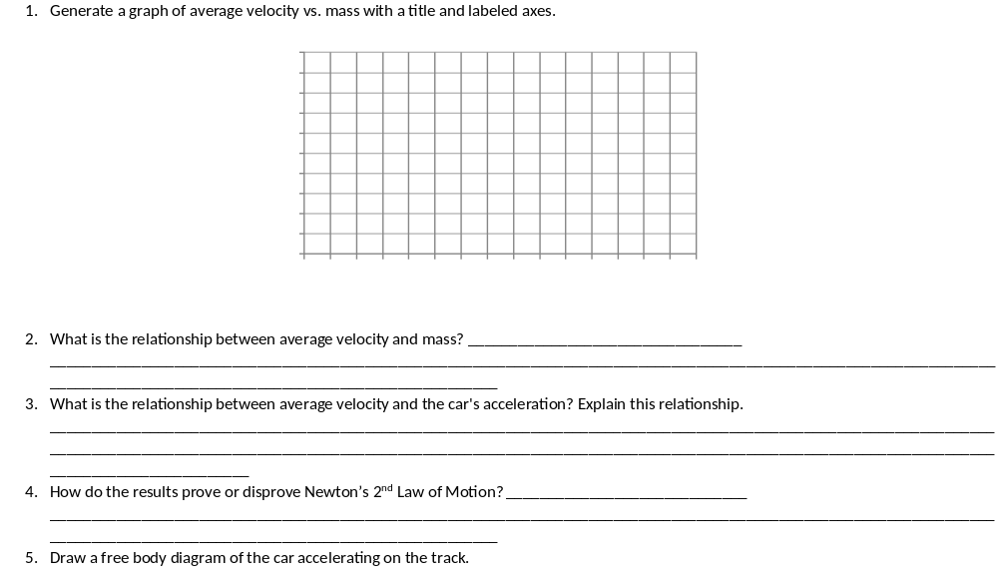
Standards: 8.PS2.3, 8PS2.4, 8.PS2.5

Slide 7
Exit Ticket:
What is Newton’s Second Law of Motion?

